Slide 1
CIRCULATORY
SYSTEM
Cardiovascular system
  Heart
  Blood vessels
  Blood
Lymphatic system
  Lymph vessels
  Lymph

Slide 2
GENERAL FUNCTIONS
OF CIRCULATORY SYSTEM
Long distance bulk transport
Overcome the limitations of diffusion
Transport gases, nutrients, waste products, immune components,heat

Slide 3
The fundamental answer
How does the circulatory system provide adequate flow to the tissue?
Pumps
Flow pathways (tubes)

Slide 4
Pumps generate pressure
This is done by contracting and relaxing, like the blood veins in people

Slide 5
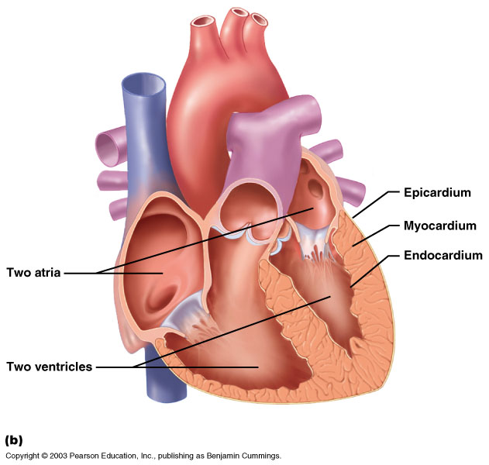
The Primary Pump
Myo- muscle

Slide 6
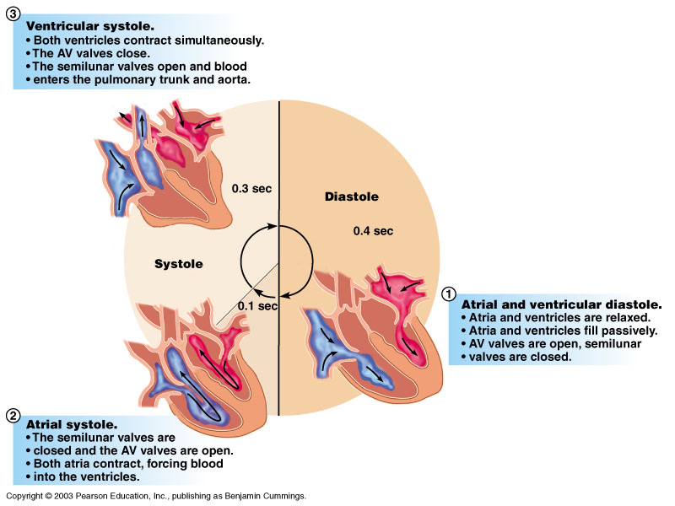
Note that blood flows out of the heart (i.e., out of the ventricles) only during a minority of the cardiac cycle
Notes:
The heart is relaxed for 0.4sec during every cycle (diastole step) to compensate, see next slide

Slide 7
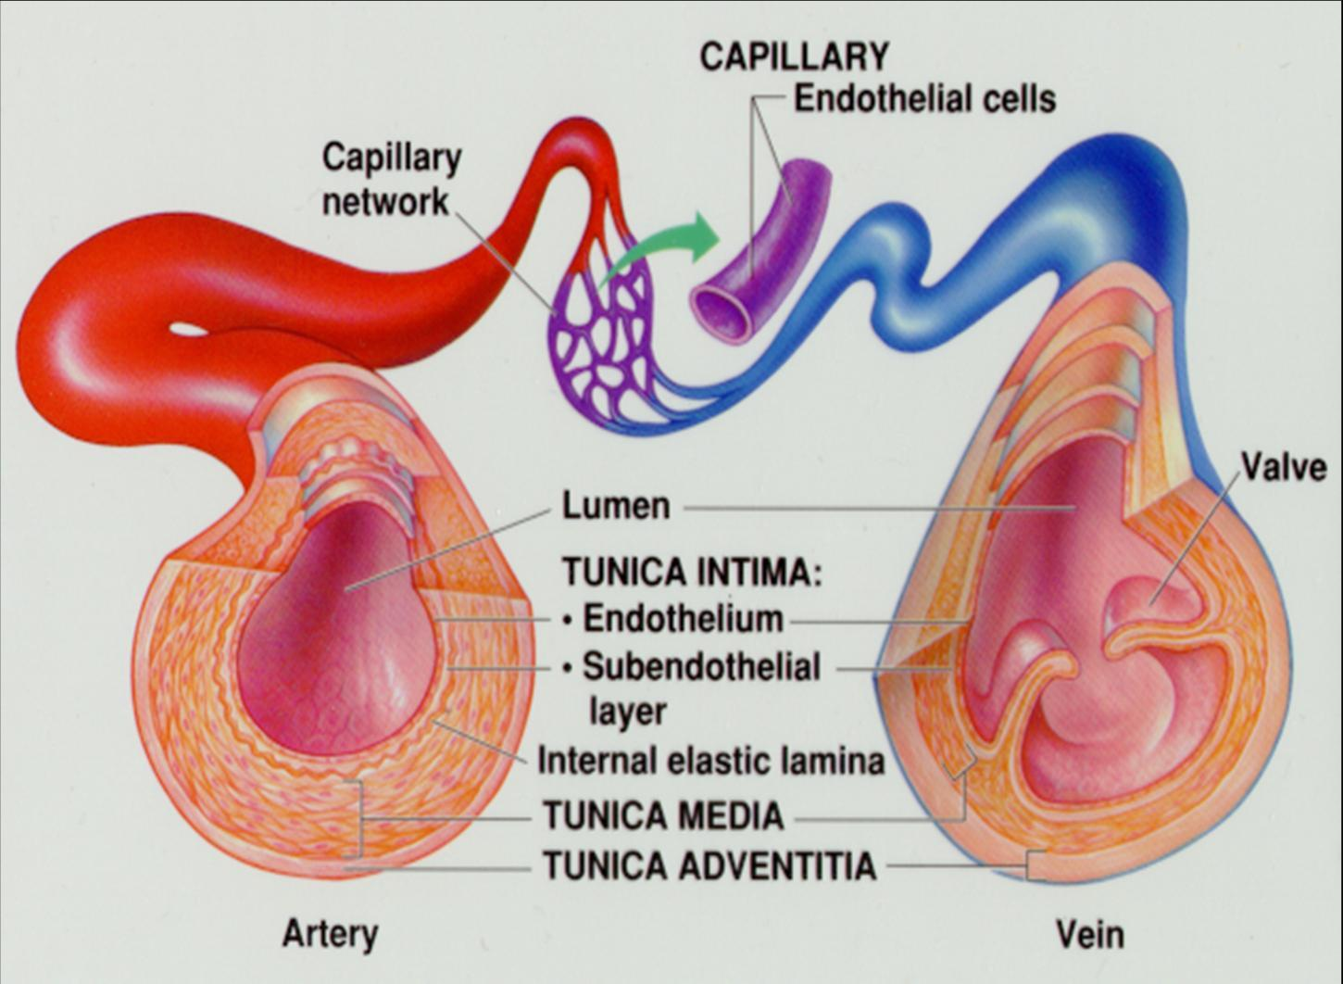
Smooth
muscle
Notes:
To compensate a valve connected to the heart closes (so blood doesn’t flow backwards) and smooth muscle in the artery squeeze

Slide 8
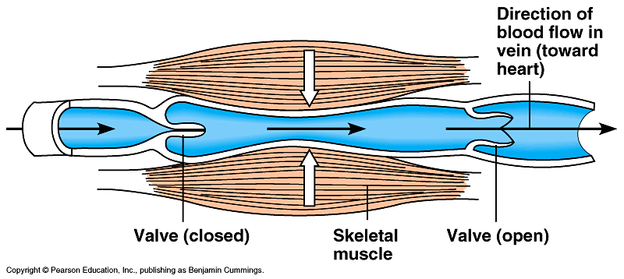
Blood flow in veins
Notes:
The skeletal muscle pump also helps by squeezing when the valve is closed

Slide 9
Blood pressure in vertebrates (mm Hg)
Pressure is adequate to drive flow
 | Systolic | Diastolic
Fish | 30 | 19
Frog | 35 | 20
Turtle | 43 | 30
Dog | 125 | 90
Notes:
Mammals (like people and dogs) have a relatively high blood pressure because we use lots of oxygen due to our metabolism and require more oxygen to get to our tissues.

Slide 10
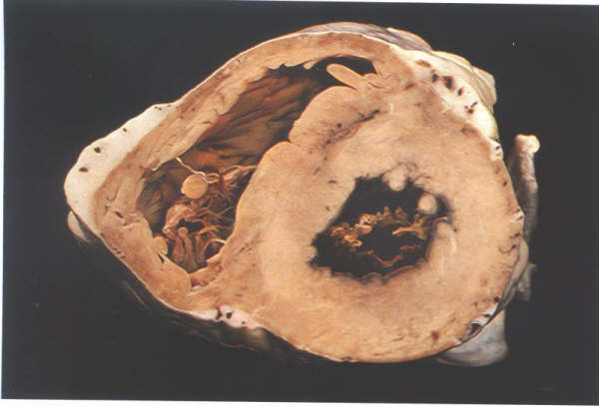
Pressure is adequate to drive flow
L
R
Notes:
The left ventricle is thicker because it pumps into the aorta (which means the blood has to travel all throughout the body), while the right ventricle is thinner because it only has to pump to the lungs.
They both pump the same volume but pumping throughout the whole body has greater resistance to flow

Slide 11
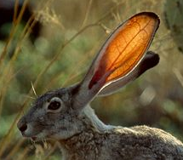
The circulatory system provides blood flow to respiratory surfaces and then to tissues
Notes:
As blood goes through the system, blood pressure decreases (highest in the heart, lowest in the veins)

Slide 12
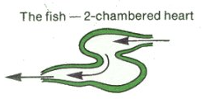
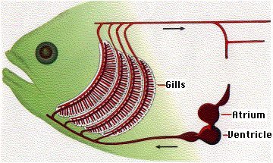

Slide 13
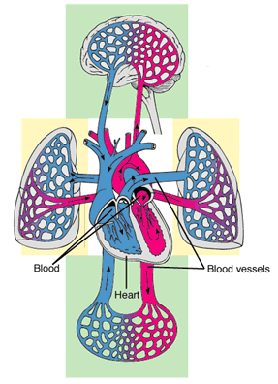
The mammalian cardiovascular system: an overview
Notes:
Blood flows from the aorta to the body (systemic circuit)
Blood flows from the right ventricle (where it gets repressured before) out to the lungs (pulmonary circuit)

Slide 14
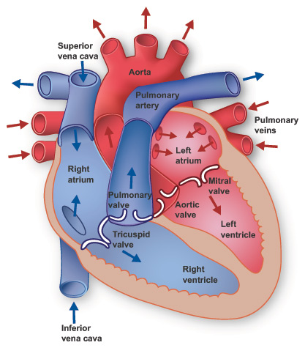

Slide 15
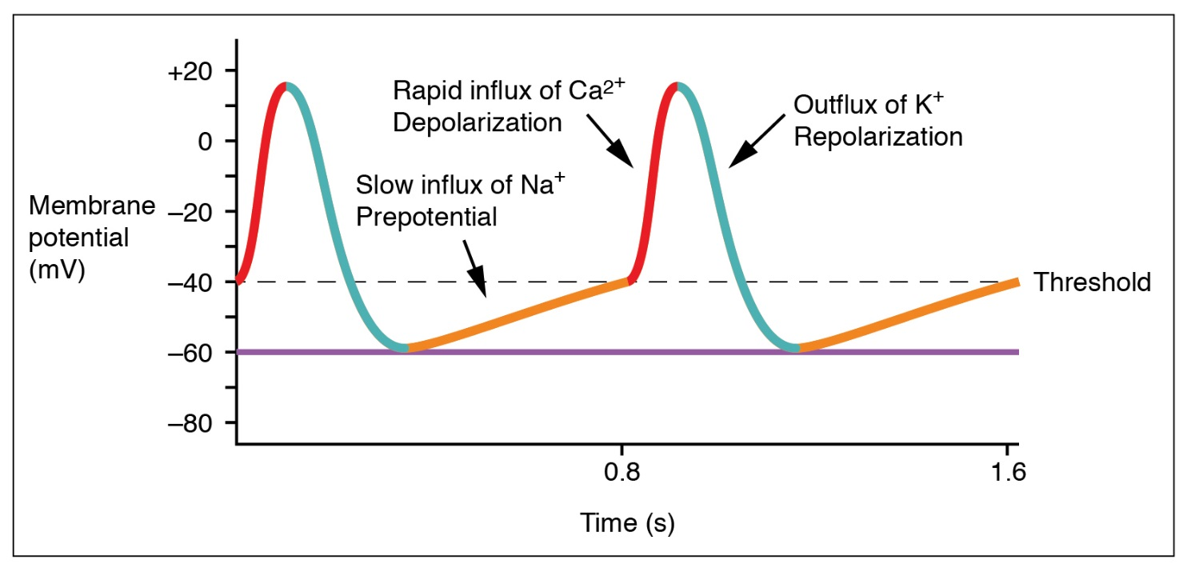
Cardiac contraction is coordinated by cellular electrical signals
SA node cell membranes are leaky
Positive ions flow in across the cell membrane
This triggers contraction
Notes:
Heart muscle cells are leaky and allow positive ions to flow in, this triggers contraction

Slide 16
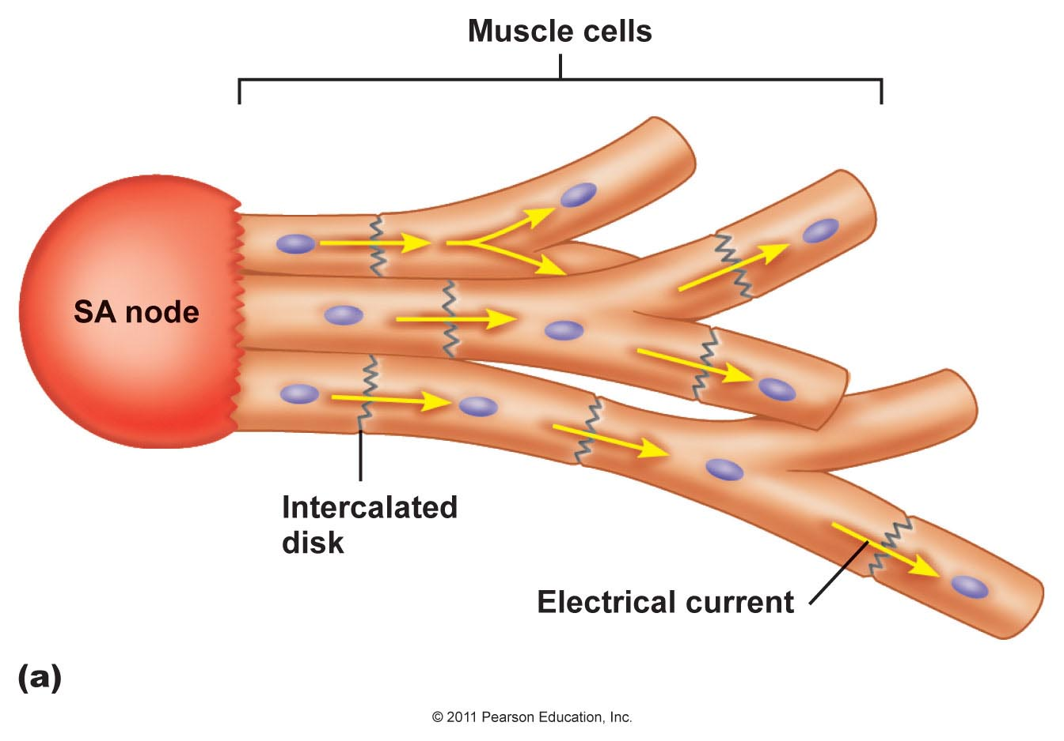
Electrical signals spread from cell to cell
Notes:
Positive ions flow best in the SA node (in the right atrium) and when the node gets triggered, it sends a signal that causes the heart muscles to contract
Because it is closer to the atrium, the atrium contracts before the ventricles contract

Slide 17
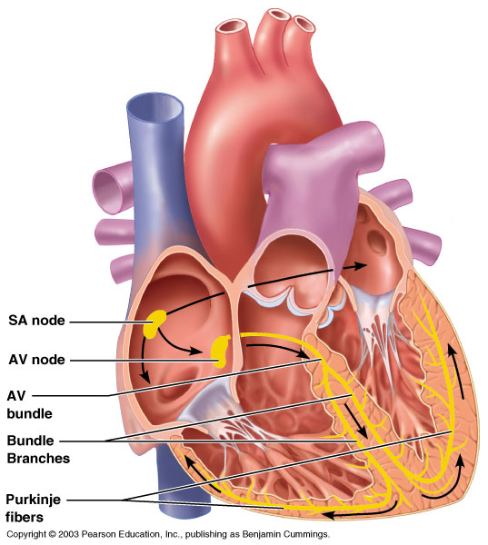
CARDIAC CONDUCTION SYSTEM
Notes:
The SA node fires a signal that passes through the atria causing them to contract, forcing blood into the ventricles
The signal then gets slowed down by the AV node before it pass through the ventricles causing them to contract, and pump the blood

Slide 18
Pressure drives flow through available pathways

Slide 19
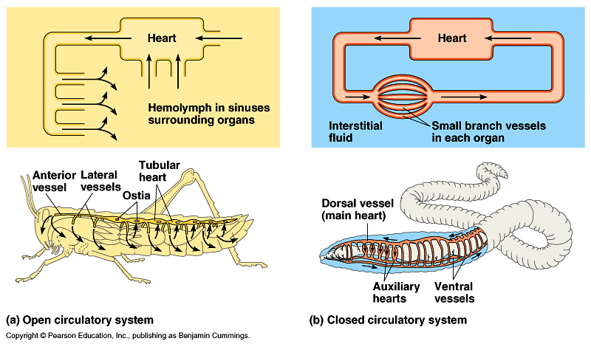
Open circulatory systems
Notes:
In insects, blood gets pumped into a space, then the pressure builds to a point where it starts flowing back to the heart

Slide 20
Closed circulatory systems

Slide 21
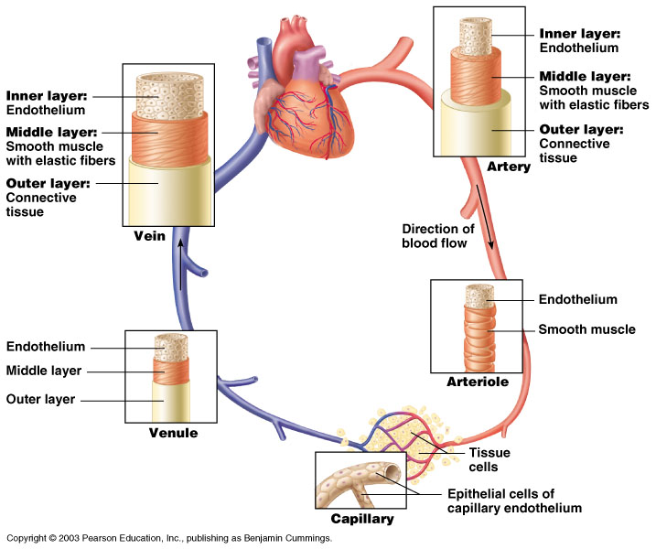
The circuit of blood vessels

Slide 22
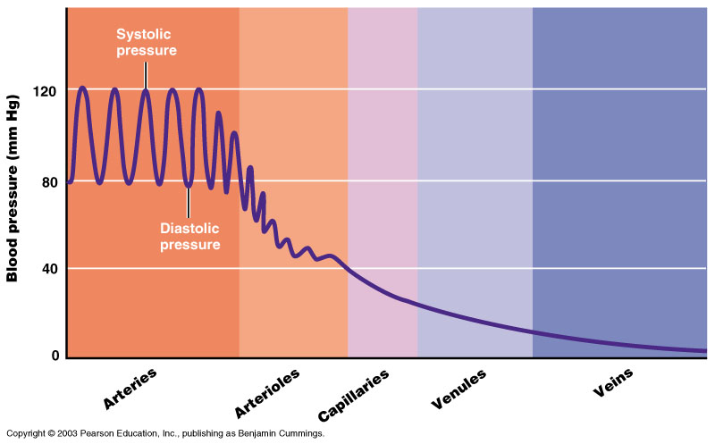
Pressure drops along the flow path

Slide 23
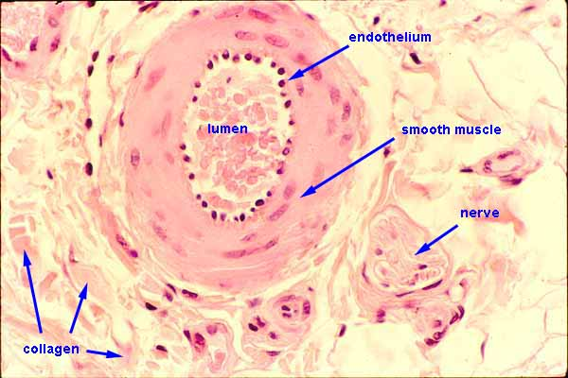
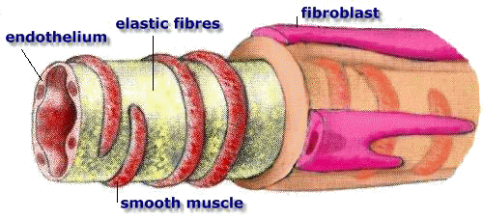
Smooth muscle provides control over vessel diameter

Slide 24
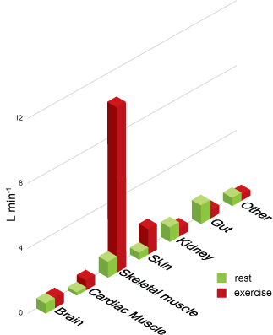
Changes in vessel diameter regulate blood flow
Notes:
Sometimes the blood pressure at different parts change due to activity (rest vs exercise)
Sometimes it doesn’t change (brain)
Sometimes it goes down (kidney, gut)
Sometimes it goes up (skeletal muscle)

Slide 25
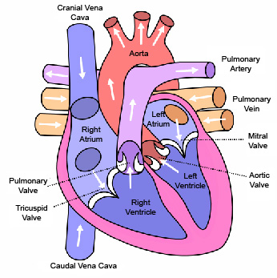
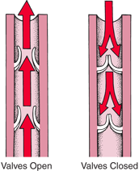
Valves prevent reverse flow (e.g., ventricle to atrium, or ‘down’ a vein) when the pressure gradient would drive flow in the “backwards” direction

Slide 26
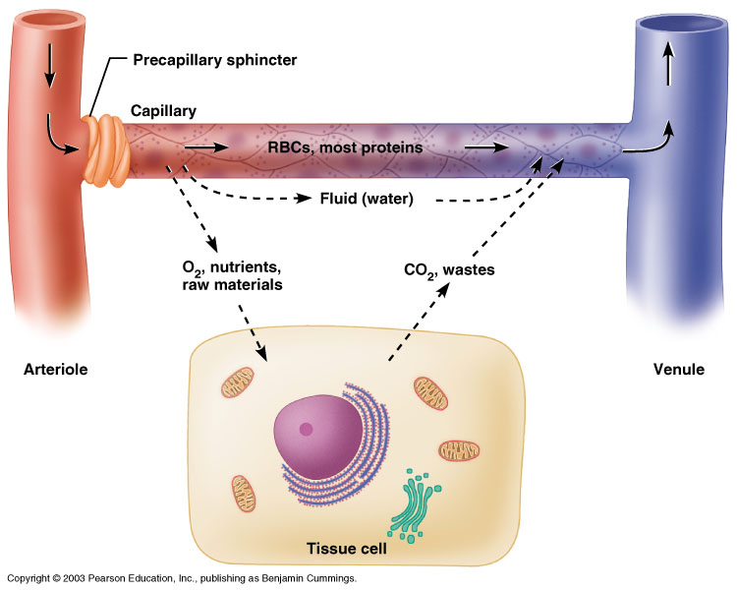
Capillaries are the site for transfer of materials between blood and tissues
Notes:
They are a single cell layer thick; they don’t have any smooth muscle, they are where exchange happens

Slide 27
Blood pressure is a primary regulated variable in the cardiovascular system

Slide 28
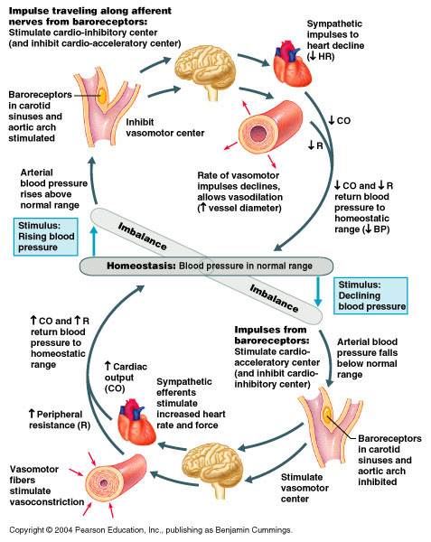
BP is regulated by negative feedback

Slide 29
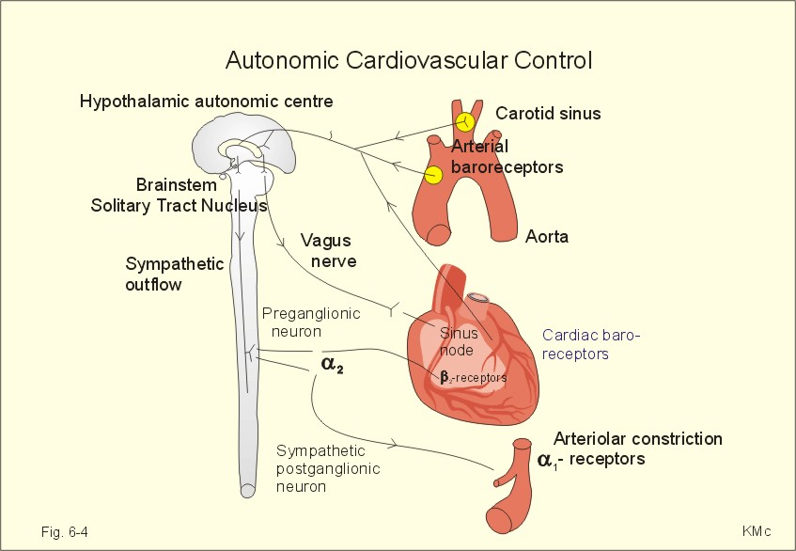
Notes:
Baroreceptors: sense what the blood pressure is

Slide 30
Regulation of BP
Blood pressure =
cardiac output X peripheral resistance
  Cardiac output (mL/min) =
  heart rate (bt/min) X stroke volume (mL/bt)
Notes:
Pressure = flow (this is how much blood flow there is)* resistance

Slide 31
Factors affecting cardiac output
Venous return
  More blood returning to the heart stretches the heart chambers, which strengthens contraction and increases stroke volume
Autonomic nervous system
  Activated by baroreceptors
  Parasympathetic (ACh, vagus nerve) HR
  Sympathetic (norepinephrine) HR
Hormones
  Adrenaline (epinephrine)

Slide 32
Factors affecting peripheral resistance (vessel dilation)
Hormones
  adrenaline may constrict or dilate
  Angiotensin constricts
Metabolism
  Elevated CO2 induces dilation
Notes:
Wider = less resistance (dilation)
Smaller = more resistance (contraction/constriction)

